Slide 1
OWF model training -- Session 1 Introduction to Pywr and OWF structure
05-12-2025
Baptiste FRANCOIS

Slide 2
Context
UMass has developed a Long-Term Vulnerability Assessment (LTVA) of the Orinoquia River Basin water supply system.
To support the LTVA, a suite of models was developed to simulate the water supply system response across a large range of future scenarios.
The Orinoquia Water Futures (OWF) was developed to simulate the operations of the water infrastructure system across the basin.
OWF is coded using Python programming language and heavily relies on the Pywr library
SCWD: Santa Cruz Water Department
OWF Training Session 1. May 12th, 2025

Slide 3
Objective of the training sessions
Train the Unillanos and Alisos staff to run the OWF to assess impact of climate change and other factors of risk on system performance
Train the Unillanos staff to use new inputs and request additional outputs to/from the OWF model
Train the Unillanos staff to assess different demand scenarios
Get the Unillanos staff familiar with the OWF code base and Pywr base
OWF Training Session 1. May 12th, 2025

Slide 4
This session: Getting familiar with Pywr library
Theory:
Get familiar with the naming convention used in Pywr/OWF
Get familiar with the organization of the code base when using Pywr library
Get to know the Pywr objects that are used in OWF
Review the different node and parameter types used in OWF
Hands-on practice (using a toy-model):
read the python and .json model file describing a simple water resource system, and be able to understand / extract information relevant to the system
To be able to run the model for this simple water resource system,
To be able to modify the model files to run different scenarios / system configurations for this simple water resource system.
OWF Training Session 1. May 12th, 2025
Notes:
Pywr is a Python library for water system modeling

Slide 5
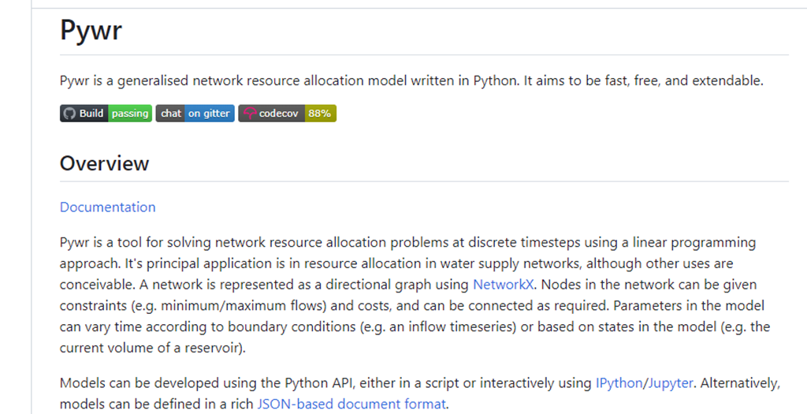
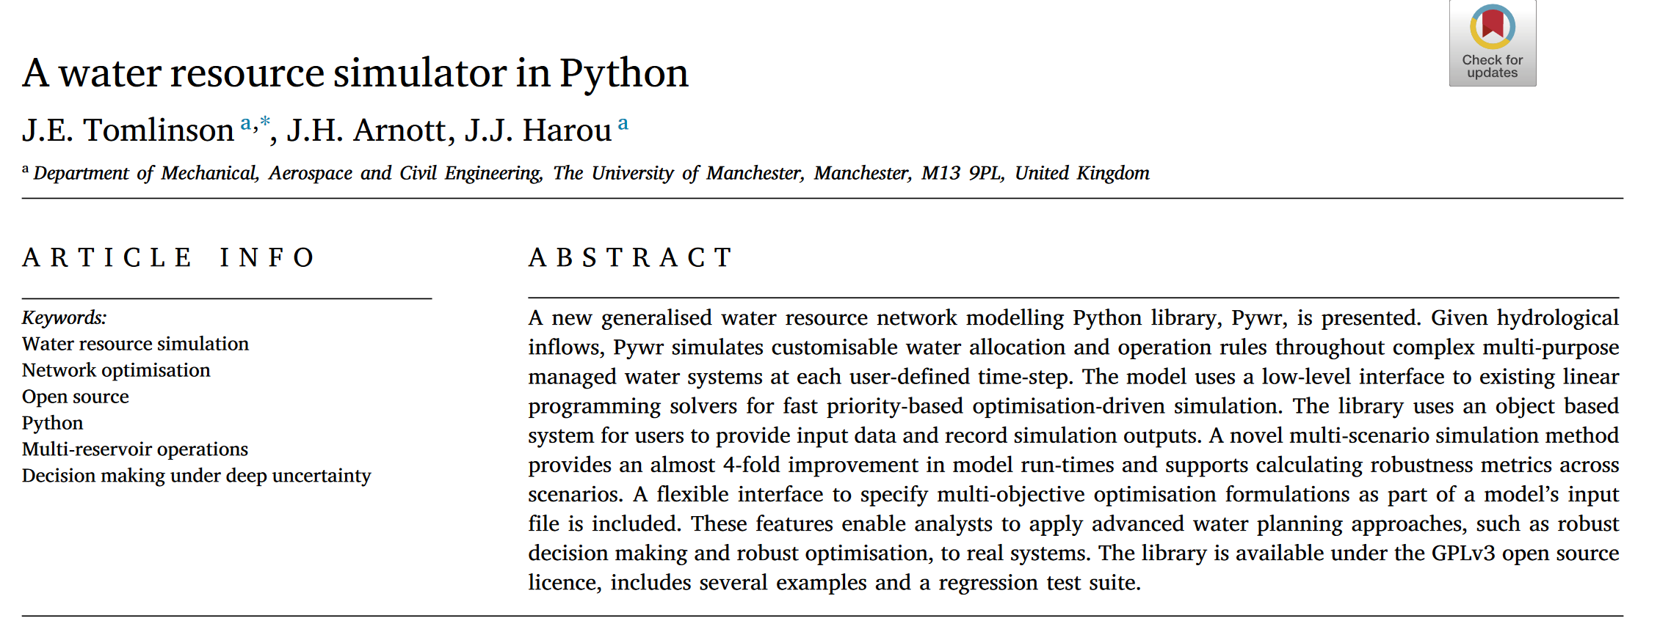
PYthon Water Resource (PYWR) library
Link to the PYWR Github:
pywr/pywr: Pywr is a generalised network resource allocation model written in Python. (github.com)
Link to the PYWR paper:
https://linkinghub.elsevier.com/retrieve/pii/S1364815219307133
OWF Training Session 1. May 12th, 2025

Slide 6
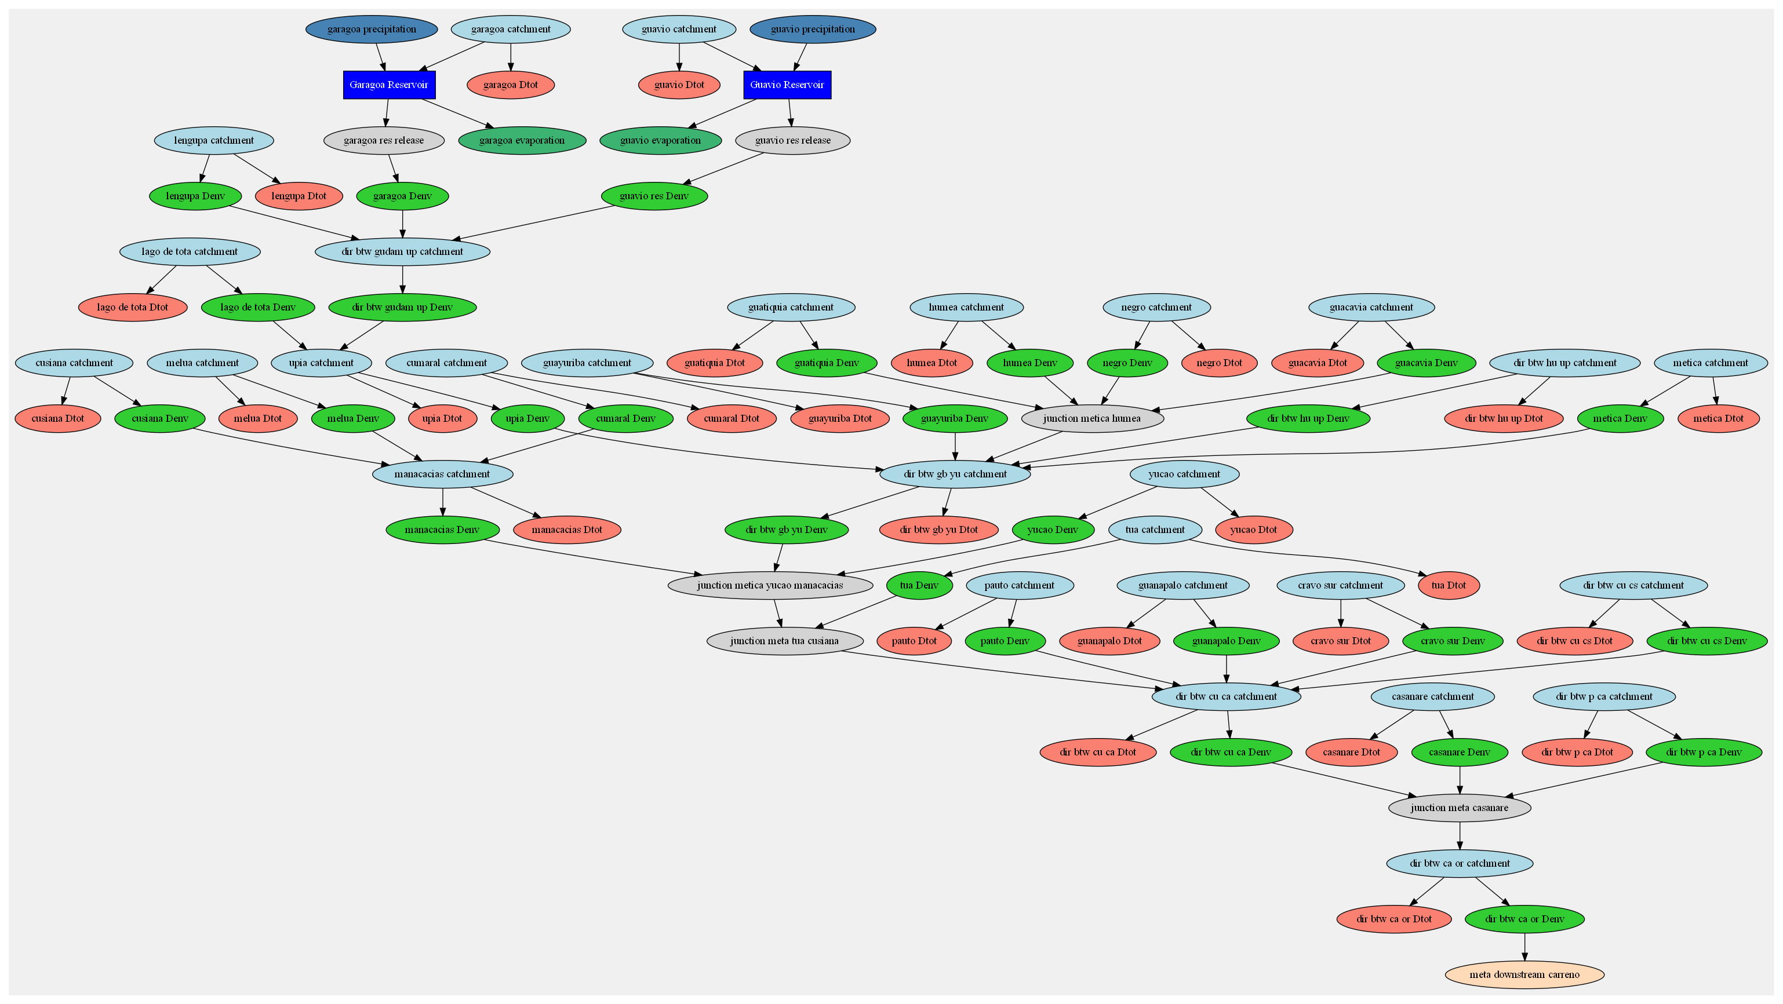

Orinoquia River Basin in OWF model
Input nodes
Output nodes
Storage nodes
Link nodes
SCWSM Training Session 1 January 19, 2024

Slide 7
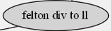
Orinoquia River Basin in OWF model
Input nodes
Output nodes
Storage nodes
Link nodes
OWF Training Session 1. May 12th, 2025

Slide 8
Description of the node types in OWF
- There are 4 basic node types in OWF, they are: input, output, storage and link nodes.
- More sophisticated node types are also used, but they are all built upon one of this basic node type.
Input nodes
Add water to the system at every time step either from an input time series (e.g., inflow to reservoir) or from a decision made by the model (i.e., pump from a groundwater well).
Output nodes
Take water out of the system at every time step (e.g., evaporation over reservoir, deliveries to customers, some river streams that leave the basin)
Storage nodes represent reservoirs across the system. Storage node is the only basic node type that can carry over water from one time step to the next.
Storage
Link nodes are used to simulate the management of various assets such as pipelines, diversion. They can also represent checkpoint along the river network where a constraint can be applied.
Link nodes
OWF Training Session 1. May 12th, 2025

Slide 9
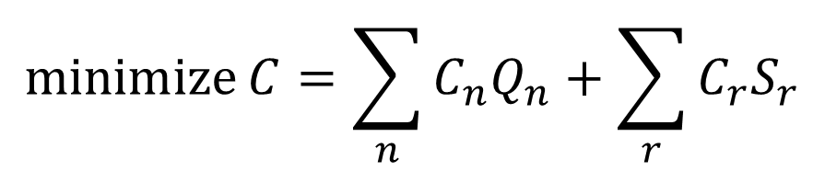
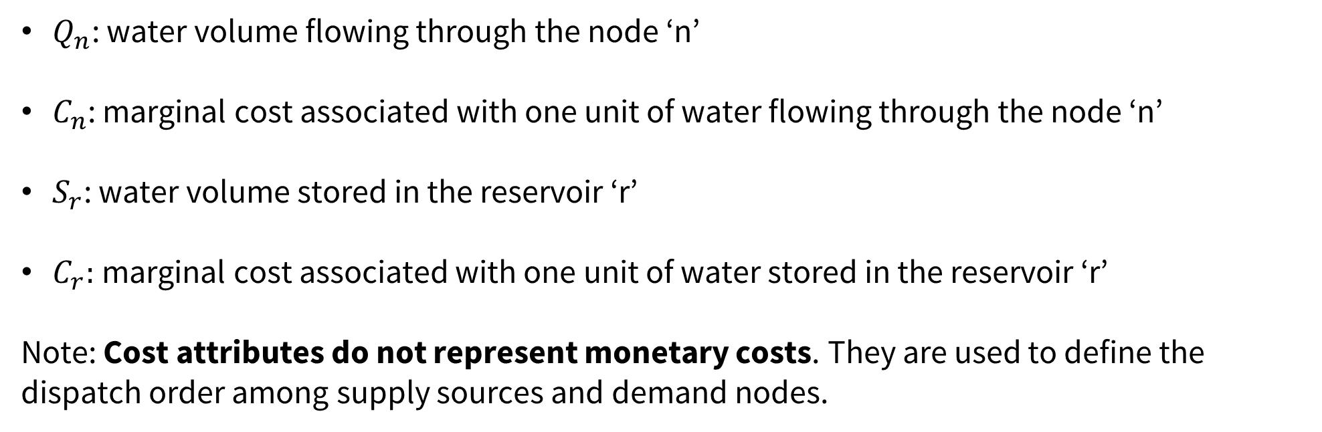
Linear Programming (LP) optimization
$$\operatorname{minimize}{C=\sum_{n}{C_{n}Q_{n}}+\sum_{r}{C_{r}S_{r}}}$$
$Q_{n}$: water volume flowing through the node ‘n’
$C_{n}$: marginal cost associated with one unit of water flowing through the node ‘n’
$S_{r}$: water volume stored in the reservoir ‘r’
$C_{r}:$marginal cost associated with one unit of water stored in the reservoir ‘r’
Note: Cost attributes do not represent monetary costs. They are used to define the dispatch order among supply sources and demand nodes.
OWF Training Session 1. May 12th, 2025

Slide 10
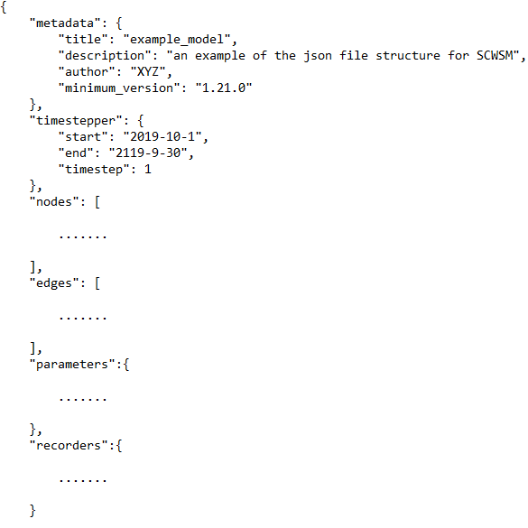
The ‘json’ format is used to describe the Orinoquia River Basins network and its management
Metadata of the model (Title, version, author, …)
Simulation period and time step (note: unit is ‘daily’)
- Input nodes (e.g., catchment, precipitation) - Storage nodes (e.g., reservoir) - Output nodes (e.g., demand, evaporation, outflow from the system) - Link nodes (e.g., stream, pipelines, tunnels)
‘Nodes’ :
Description of the connection among ‘nodes’ (e.g., input_node_1 flows into storage_node_1)
Define the constraints associated with the different nodes, although the usage of parameters
in the modeling framework may vary.
List of the state variables to be monitored and outputted by the model.
Notes:
git clone https://github.com/BaptisteFrancois/SantaCruz_modeling.git --branch umass_training --single-branch Training

Slide 11
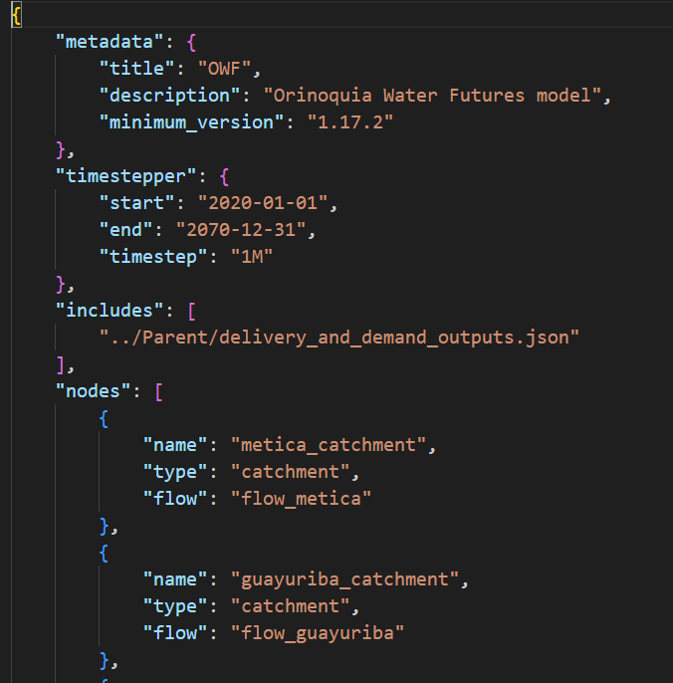
The ‘json’ format is used to describe the Orinoquia River Basins network and its management
OWF Training Session 1. May 12th, 2025

Slide 12
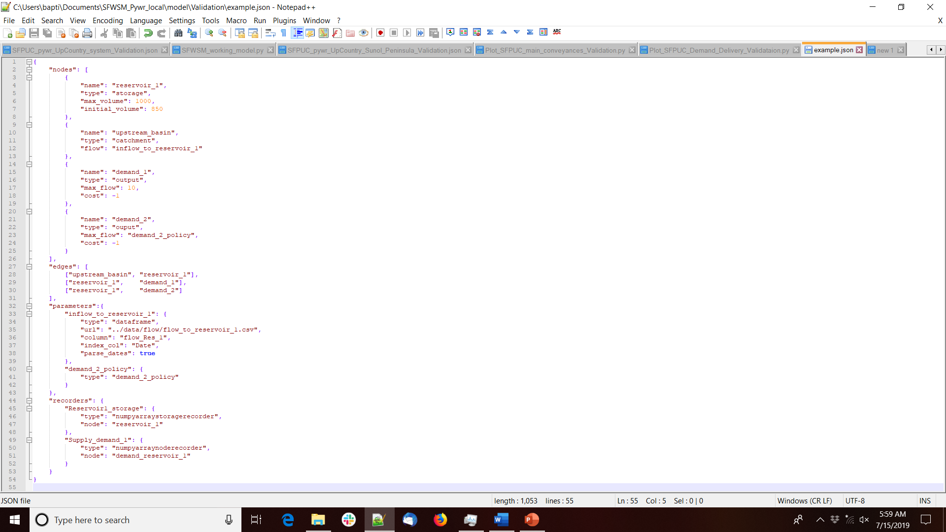
Let’s start with a simple example:
upstream basin
reservoir_1
demand_1
demand_2

Slide 13
Let’s start with a simple example:
upstream basin
reservoir_1
demand_1
demand_2

Slide 14
Let’s start with a simple example:
upstream basin
reservoir_1
demand_1
demand_2

Slide 15
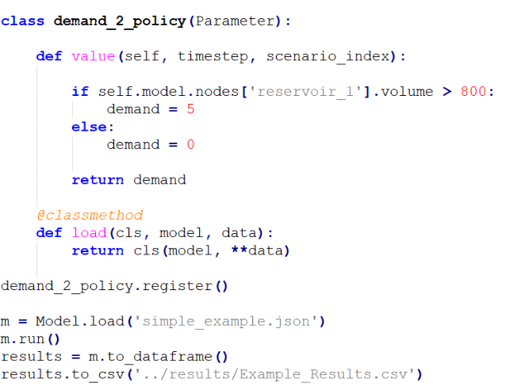
Let’s start with a simple example:
upstream basin
reservoir_1
demand_1
demand_2

Slide 16
Let’s start with a simple example:
upstream basin
reservoir_1
demand_1
demand_2

Slide 17
How to run OWF model
Select your working directory, and open a terminal
Using the git command “git status”, check the current git branch you have currently active
If needed switch branch using the command “git switch ‘your_branch’”
Update your branch using the “git pull” command. This will ensure that your local branch includes the latest updates to the code your dear colleagues may have made while you were log off
Activate the conda environment: “conda activate owf_env”
Go to the ‘/script’ folder
Type “python OFW_CST.py ”
Note that step 7 will use model parameters and climate and demand scenarios that are defined in different text file or python module that will be detailed in the last training session.
OWF Training Session 1. May 12th, 2025

Slide 18
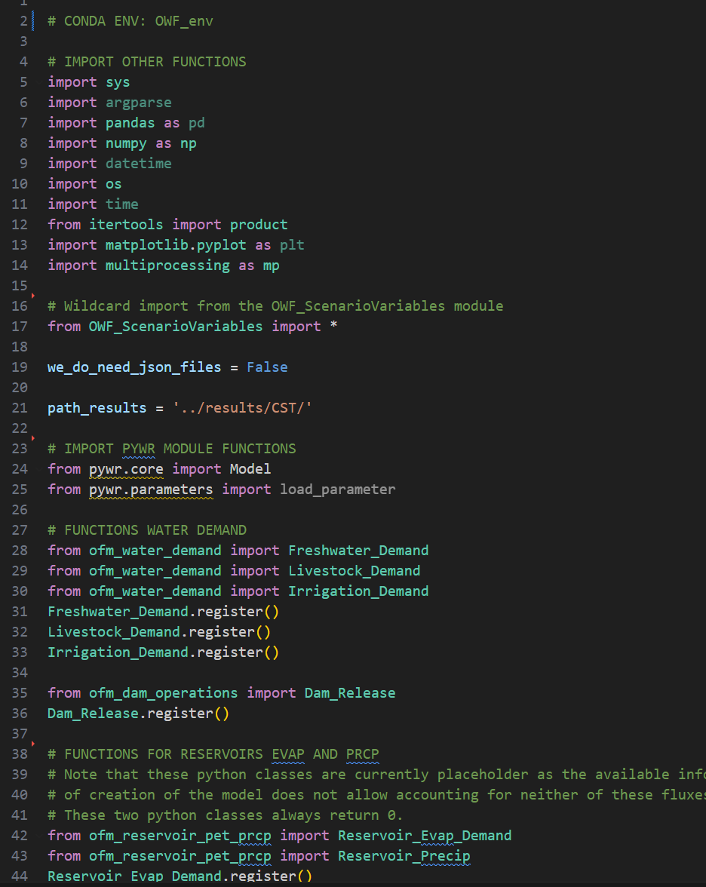
What does happen when running OWF_CST.py script ?
Screenshot of the OWF_CST.py script
Steps that are processed in the script:
Import the required Python library
Load python class objects from different python modules Those modules are simply python scripts that contains python ‘classes’ or ‘functions’ that are used to simulate the operations of the system.
Screenshot of the first lines of the SCWSM_Option_Analysis_CST.py script
OWF Training Session 1. May 12th, 2025

Slide 19
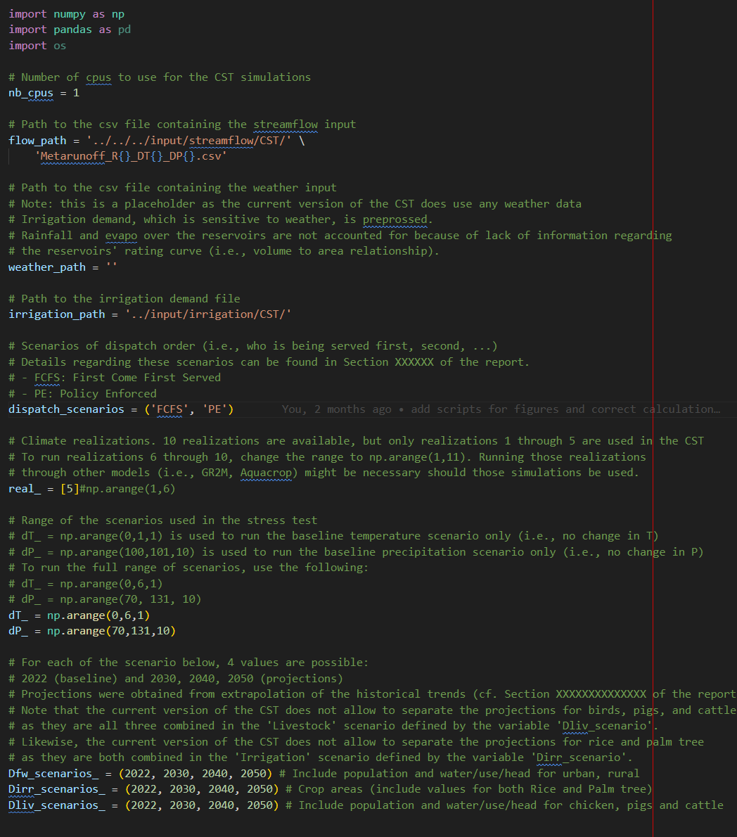
Screenshot of the OWF_ScenarioVariables.py module
Screenshot of the OWF_CST.py script

Slide 20
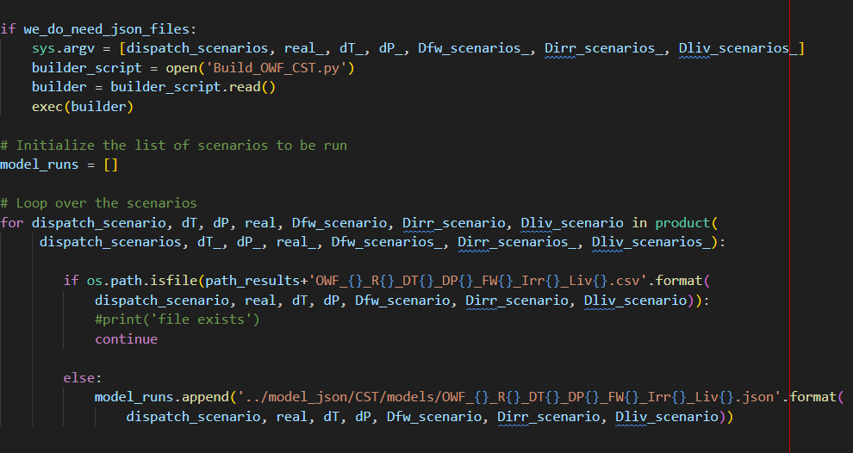
What does happen when running OWF_CST.py script ?
Screenshot of the OWF_CST.py script
Steps that are processed in the script:
3. Create the model .json files for the considered scenarios The .json files are structured text files where the water system (i.e., reservoir, rivers, demand nodes, …) are represented.
Build_OWF_CST.py module creates .json files for a selection of scenarios.
The list of scenarios is defined by the keys in the sys.argv list.
Screenshot of the OWF_CST.py script
This ‘for’ loop is used to create a list of scenarios to be run by the model.
From the combination of scenarios listed in the sys.argv variable, only the ones for whom an output file does not exist will be run through the model
Screenshot of the first lines of the SCWSM_Option_Analysis_CST.py script
OWF Training Session 1. May 12th, 2025

Slide 21
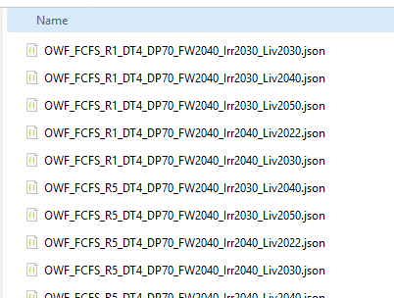
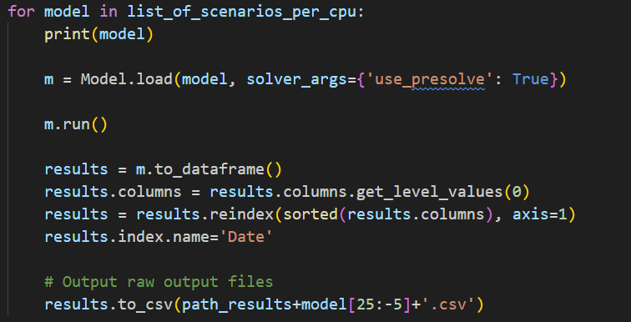
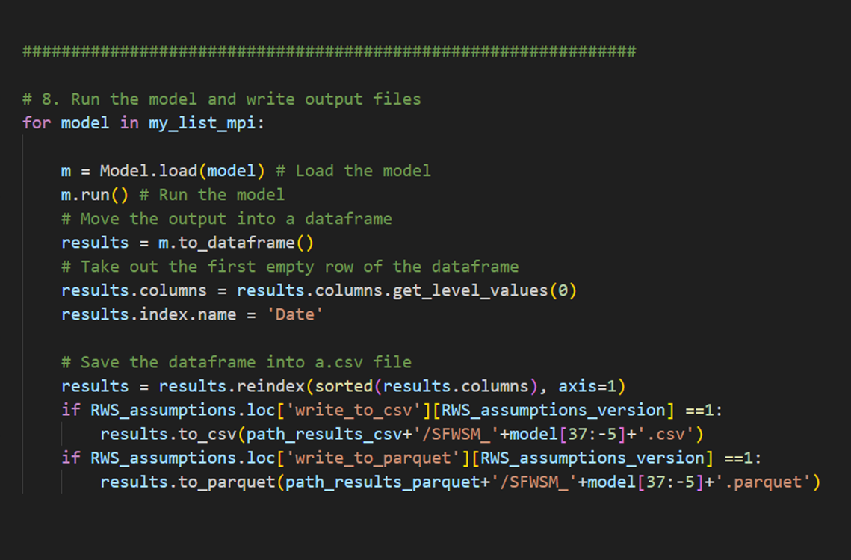
4. Run the model and write the output files
Loop over the scenario to be run
Load the relevant model file
Run the model
Convert the model output into a dataframe
Some formatting of the data
Order the column per alphabetic order
Add a name for the ‘index’ column
The output are saved in .CSV file format
Note: A few additional steps are in fact present in the OWF code to cope with parallel computing. This will be cover in the last training.
OWF Training Session 1. May 12th, 2025

Slide 22
Description of the node types used in OWF
OWF Training Session 1. May 12th, 2025

Slide 23
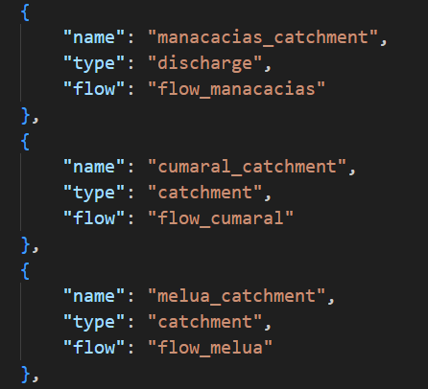
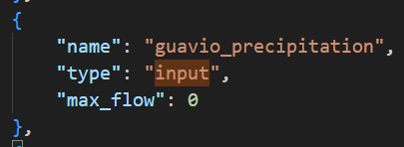
Node Type: Input
Example of nodes using the ‘input’ type:
Precipitation over
- Inflow from headwater basins
Example of input node: rainfall over Guavio Reservoir
Example of input node 2: “catchment” nodes are input nodes that requires only a ‘flow’ attribute (‘max_flow’ and ‘min_flow’ attributes are equal)

Slide 24
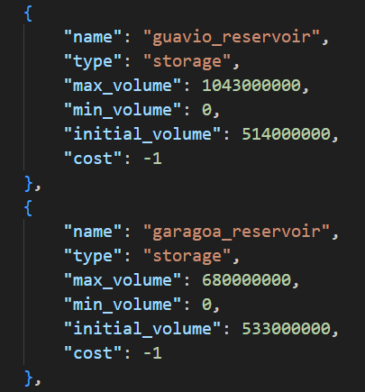
Node Type: Storage
Guavio and Garagoa are the only reservoirs represented in OWF
Attribute values can be assigned directly from the node section (e.g., max_volume, min_volume, initial_volume, …)
OWF Training Session 1. May 12th, 2025

Slide 25
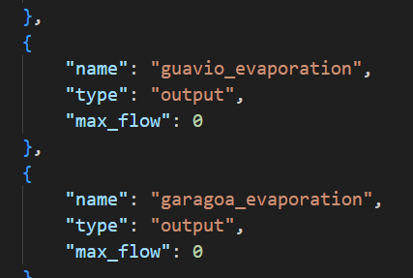
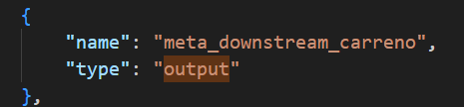
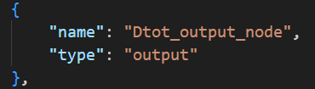
Node Type: Output
Output node used for the outlet of the Orinoquia River basin
Output node used for the evaporation over the reservoirs
Water withdrawals from all demand nodes flow into an ouput node an leave the system
OWF Training Session 1. May 12th, 2025

Slide 26
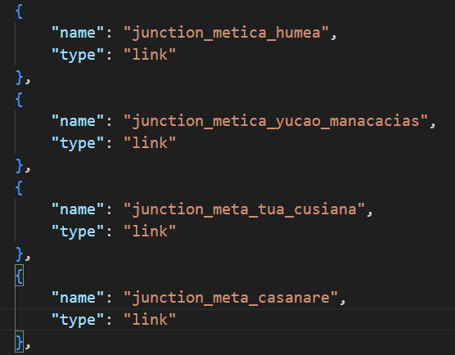
Node Type: Link
Example of nodes using the ‘link’ type:
Streams
Confluence between streams
Points along the river network to check (or enforce) the minimum flow requirement
OWF Training Session 1. May 12th, 2025

Slide 27
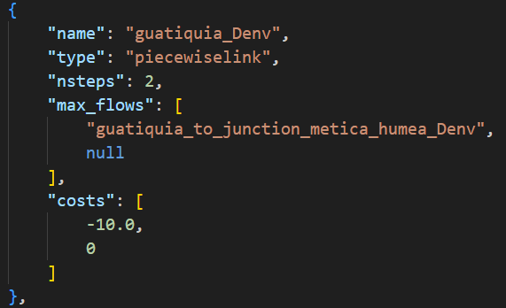
Node Type: Piecewiselink
Piecewiselink node is an extension of the typical link node with a piece wise cost function.
Note: Piecewise links are used to model situations where there is a specific benefit (e.g., cost) of supplying certain flow rates, but beyond this fixed flow values, the benefit changes.
The `nsteps` attribute refers to the number of pieces in the piecewiselink (which is also the number of elements in the lists defined in the `max_flows` and `costs` attributes. The value of the `nsteps` attribute must be larger than 1.
Note that, contrary to the other type of nodes, the attributes `max_flows` and ‘nodes` use the plural form, indicating that multiple values are expected.
Tip: The string ‘null’ can be used in place of the last flow rates to indicate the absence of flow constraint (usually associated with null or positive costs)
Example of piece wise link in Felton Diversion to San Lorenzo River
OWF Training Session 1. May 12th, 2025
Notes:
Piecewise links are used to assigned different cost values to different water volume passing through the same node.
Here felton buffer value is 0.323MGD/0.5 cfs. The corresponding cost is -5000

Slide 28
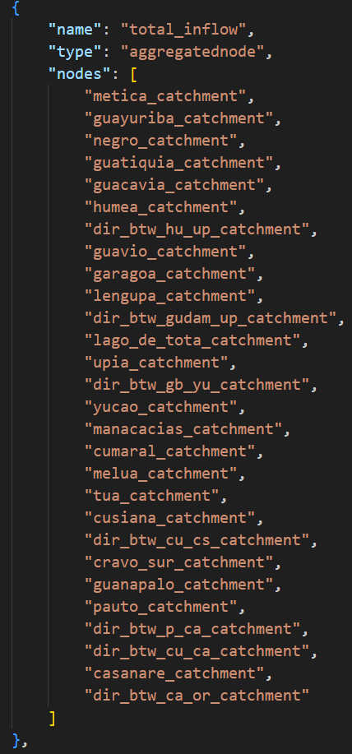
Node Type: Aggregated Node
Aggregated nodes (and storage nodes) are not connected to the network (i.e., they do not appear in the “edges” section).
Aggregated noded are used to either i) track flow/storage through multiple nodes, or ii) apply constraints to multiple nodes at once.
When a constraint in applied, for instance using the `max_flow` attribute, the constraint applies to the sum of the flow passing through all the nodes listed in the `nodes` attributes.
Note: In OWF, there is a single ‘aggregatednode’ that can be used to track the total inflow to the system

Slide 29
Description of the parameter types used in OWF
OWF Training Session 1. May 12th, 2025

Slide 30
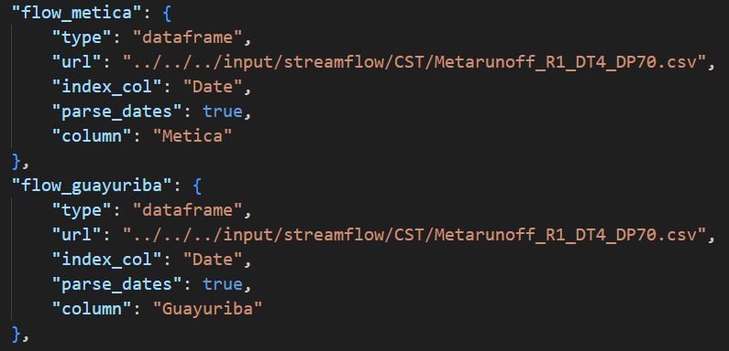
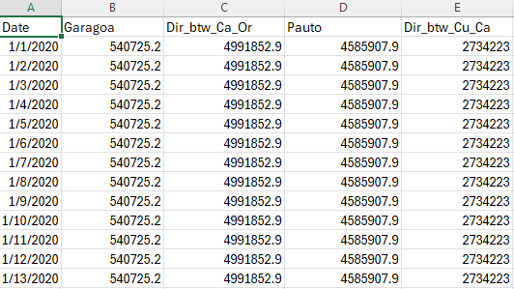
Parameter Type: DataFrame
Dataframe parameters are used to read time series. These time series are most often used to assign values at every time step to node attributes (e.g., max_flow or min_flow)
Example of a dataframe parameters reading streamflow time series at the Majors Creek
Input file for the streamflow data (m3s-1)
“url”: path to the input file (relative oath from the directory of the json file)
“column”: name of the column to read
“index_col”: name of the column used for the index
“parse_dates”: must be true of the dataframe hosts time series
OWF Training Session 1. May 12th, 2025

Slide 31
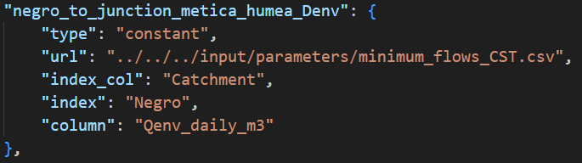
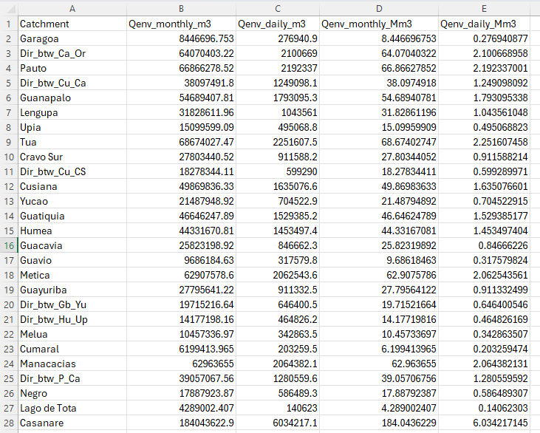
Parameter Type: Constant
Constant parameters are used to specified attributes values that remain constant throughout the simulation (e.g., minimum flow constraints that are constant, costs assigned to nodes, ..)
Example of constant parameter: Demand for environmental flow (Denv)
“url”: path to the relevant input file (relative oath from the directory of the json file)
“index_col”: name of the column used for the index
“index”: name of the index (i.e., row) where to pick the value
“column”: name of the column where to pick the value
Content of the ‘minimum_flows_CST.csv’ file
OWF Training Session 1. May 12th, 2025

Slide 32
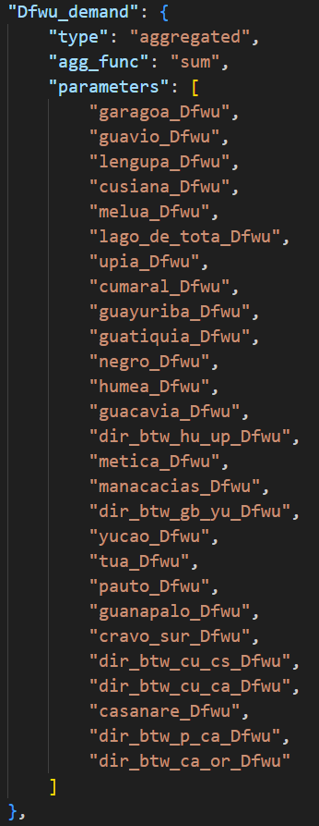
Parameter Type: Aggregated
Aggregated parameters are used to apply basic operations on parameters.
“agg_func”: type of operation to be executed by the aggregated parameters. Supports operations like ‘product’, ‘sum’, ‘min’, ‘max’..
Note that Pywr does not support subtraction. To subtract one value from another, the subtracted value must be first converted to its opposite using a “negative” parameter and then summed to the first value (not used in OWF).
“parameters”: list of the parameters for which the operations will be executed
This screenshot shows an aggregated parameter that returns the sum of the urban demand (Dfwu) across all demand nodes in the basin.

Slide 33
Parameter Type: customized
Pywr developers give the ability to the modeler to write their own model parameters.
In this case, the “type” attribute must match the name of a python class the modeler must create where the operations made by this new parameter are defined
More details on customized parameters, and their use in OWF model, will be provided in the last training session.
OWF Training Session 1. May 12th, 2025

Slide 34
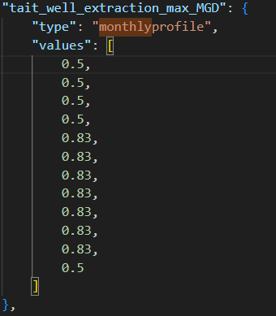
Parameter Type: Monthly profile (not used in OWF)
Monthly profile parameter are used to represent variables that depend on the calendar month. The value of this parameter is constant for all days within the same calendar month, and vary from calendar month to calendar month.
“values”: a set of 12 values giving the values taken by the parameter for during specific calendar month. The first value is for January while the last value is for December.
Note: a “dailyprofile” parameter also exists (although not used in SCWSM). Similar to the “monthlyprofile” parameter, the “value” attribute contains in this case 366 values (first value being January 1st while the 365th (or 366th during leap year) is December 31st.
Example of monthly profile parameter: the extraction rate of Tait well
OWF Training Session 1. May 12th, 2025

Slide 35
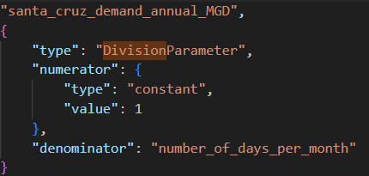
Parameter Type: DivisionParameter (not used in OWF)
Division parameters are used to calculated between two values (“numerator” and “denominator”)
Example of ‘division’ parameter
OWF Training Session 1. May 12th, 2025

Slide 36
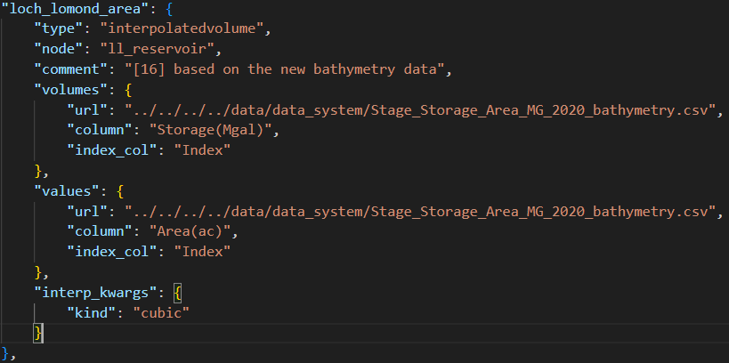
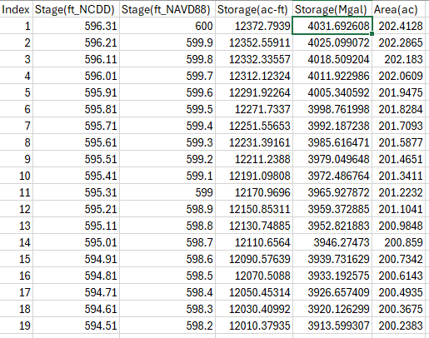
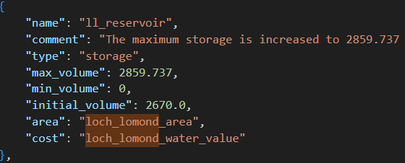
Parameter Type: Interpolated Volume (not used in OWF)
InterpolatedVolume parameters are used estimate reservoir area or level from the reservoir volume.
Loch Lomond Reservoir Stage_Storage_Area_Bathymetry.csv
Example of the “loch_lomond_area” parameter
- “node”: name of the storage node from which the volume will be used to predict the area
The storage / elevation / area curves are read from an input file. “volumes” and “values” attributes define the path to the file (i.e., “url”) and the name of the “column” where the find the relevant data.
“interp_kwargs” allows to choose the type of interpolation the user wants to use (e.g., linear, cubic spline, …)
Storage node “ll_reservoir”

Slide 37
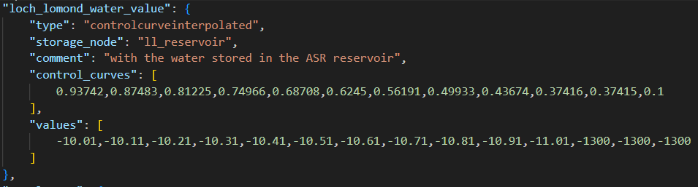
Parameter Type: Control curve interpolated (not used in OWF)
Control curve interpolated parameters are used to represent change in costs with the storage level in a reservoir. They are similar to what a piecewise link is for the link nodes but for storage.
“storage_node”: reservoir to which the water value is evaluated
“control_curves”: knots at which the slope of the marginal cost changes
“values”: cost values at the different knots. First and last values are for the reservoirs being full or empty, respectively
OWF Training Session 1. May 12th, 2025

Slide 38
List of recorder types used in SCWSM
OWF Training Session 1. May 12th, 2025

Slide 39
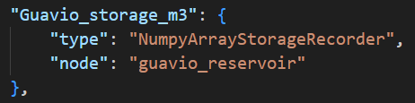
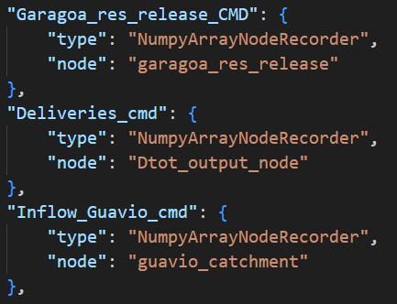
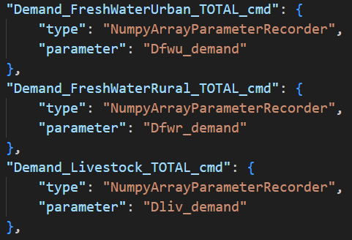
3 types of recorders are used in SCWSM
Storage recorder
NumpyArrayStorageRecorder
Node recorder
NumpyArrayNodeRecorder
Parameter recorder
NumpyArrayParameterRecorder
OWF Training Session 1. May 12th, 2025

Slide 40
Hands-on session / Homework
OWF Training Session 1. May 12th, 2025

Slide 41
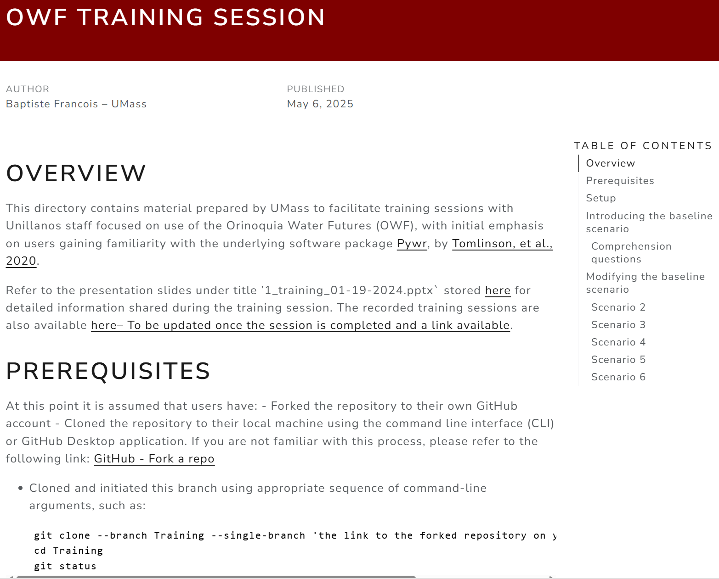
Hands-on session / Homework
Look for the ‘readme.html’ file in the ‘Training/UMass_training_01’ directory, and double-click on the file
The page below should open in your web-browser
OWF Training Session 1. May 12th, 2025
Notes:
conda activate scwsm_training_01
cd scripts
python WaterTown_Model.py

Slide 42
Water Town: your very first pywr model
Water Town gets its fresh water from the Little Loch Reservoir that receives its inflow from a single upstream catchment. Inflows to the reservoir are highly seasonal and vary from year to year. Little Loch valve release capacity is 1,500 AF/day.
Little Loch Reservoir manager must ensure a minimum flow requirement that varies throughout the year:
from August through March: 100AF/day;
May: 400AF/day;
otherwise: 200AF/day.
Water Town demand is constant through the year (450 AF/day).
During droughts, the Little Loch Reservoir drawdowns to critical level that forces the manager to reduce the delivery to water town
if Little Loch storage below 50% capacity, delivery reduced by 50%
if Little Loch below 25% capacity, delivery is reduced by 75%
Little Loch manager and Water Town decision makers are expecting a reduction in streamflow due to climate change and an increase in demand due to increasing population.

Slide 43
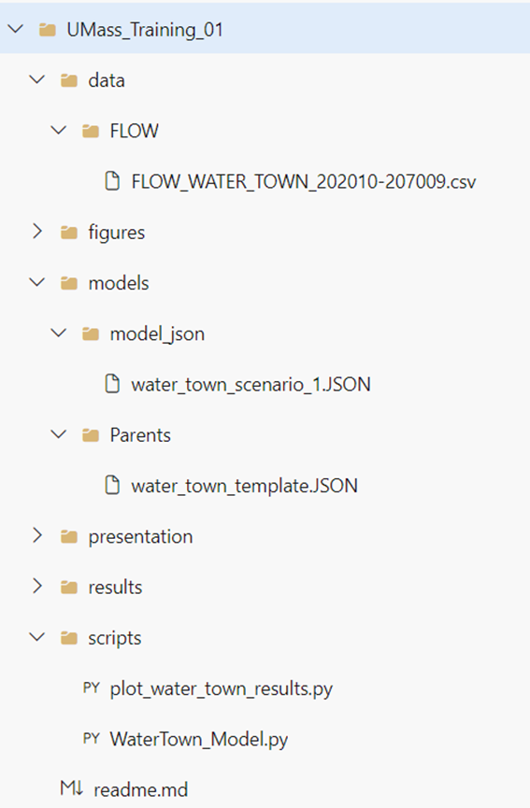
Hands-on session
Do we have enough information to create a Pywr model that represent the water town system?
If you are willing to give it a try, a good place to start is the ‘water_town_template.json’ located in the /models/Parents directory
The ‘water_town_scenario_1.json’ file in the /models/model_json directory together with the python script ‘WaterTown_Model.py’ provide an example of what would work to simulate the water town water system.
It is suggested to go over the Comprehension Questions located in the readme.md file.
These questions were elaborated to develop your understanding of the code and get your familiar with many concepts that were explored during the training.
Screenshot of the ‘Umass_Training_01’
SFPUC Training Session 1. September 12, 2023

Slide 44
Homework assignment: 6 exercises
Scenario 1
Little Loch (LL) Storage: 200,000 AF (ini:180,00 AF)
Current climate Little Loch inflow
Daily Water Town demand: 450 AFD
Deliveries cut by half if LL < 50% max storage
Deliveries cut by 75% if LL < 25% max storage
Scenario 4
Little Loch (LL) Storage: 250,000 AF (ini:180,00 AF)
Current climate Little Loch inflow
Daily Water Town demand: 450 AFD
Deliveries cut by half if LL < 50% max storage
Deliveries cut by 75% if LL < 25% max storage
Scenario 2
Little Loch (LL) Storage: 200,000 AF (ini:180,00 AF)
10% reduction in Little Loch inflow
Daily Water Town demand: 450 AFD
Deliveries cut by half if LL < 50% max storage
Deliveries cut by 75% if LH < 25% max storage
Scenario 5
Little Loch (LL) Storage: 250,000 AF (ini:180,00 AF)
Current climate Little Loch inflow
Daily Water Town demand: 550 AFD
Deliveries cut by half if LH < 50% max storage
Deliveries cut by 75% if LH < 25% max storage
Scenario 3
Little Loch (LL) Storage: 200,000 AF (ini:180,00 AF)
20% reduction in Little Loch inflow
Daily Water Town demand: 450 AFD
Deliveries cut by half if LL < 50% max storage
Deliveries cut by 75% if LL < 25% max storage
Scenario 6
Little Loch (LL) Storage: 250,000 AF (ini:180,00 AF)
Current climate Little Loch inflow
Daily Water Town demand: 550 AFD
Deliveries cut by half if LL < 35% max storage
Deliveries cut by 75% if LL < 15% max storage
OWF Training Session 1. May 12th, 2025

Slide 45
QUESTIONS & ANSWERS

